Slide 1

Class5
CSC 495/583 Topics of Software Security
Calling Convention, System Call & Introduction to PEDA and Pwntools Dr. Si Chen (schen@wcupa.edu)

Slide 2
Review

Slide 3
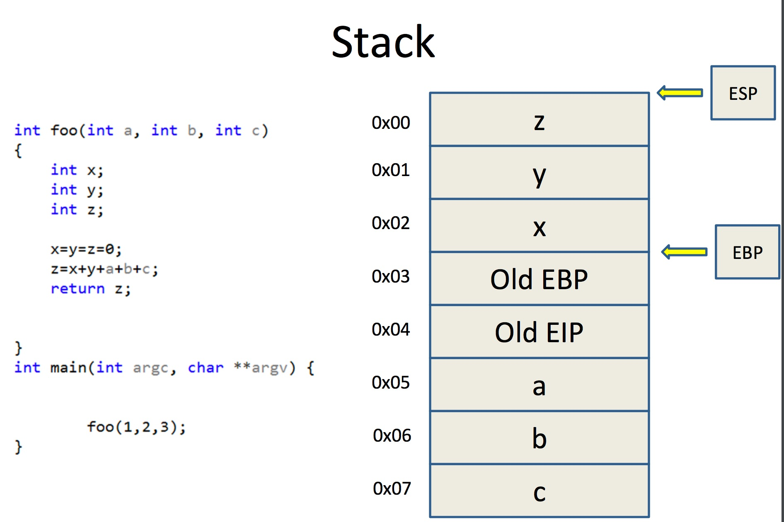

Slide 4
Calling Convention

Slide 5
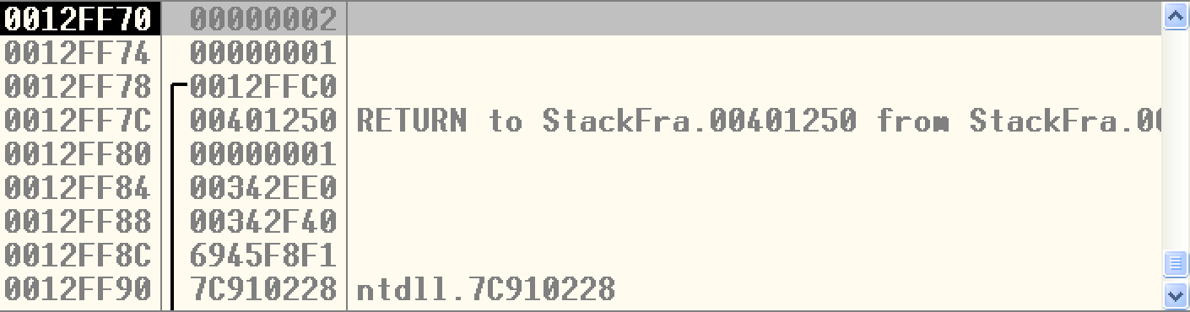
Two Questions
Q: When a function finished, how to handle the parameter left in the stack.
Q: When a function finished, how change the ESP value?
A: We don’t care…
A: ESP should be restored to the previous value

Slide 6
Standard C Calling Conventions
Calling conventions are a standardized method for functions to be implemented and called by the machine.
A calling convention specifies the method that a compiler sets up to access a subroutine.
There are three major calling conventions that are used with the C language on 32-bit x86 processors:
CDECL
STDCALL,
FASTCALL.

Slide 7
CDECL
The C language, by default, uses the CDECL calling convention
In the CDECL calling convention the following holds:
Arguments are passed on the stack in Right-to-Left order, and return values are passed in eax.
The calling function cleans the stack. This allows CDECL functions to have variable-length argument lists.

Slide 8
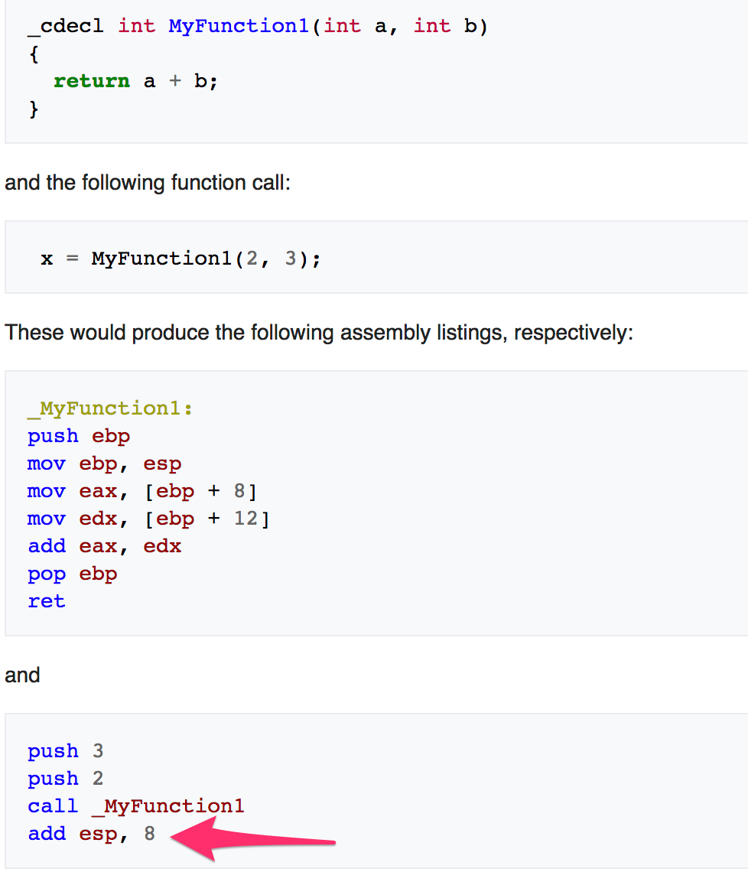
STDCALL
The C language, by default, uses the CDECL calling convention
In the CDECL calling convention the following holds:
Arguments are passed on the stack in Right-to-Left order, and return values are passed in eax.
The calling function cleans the stack. This allows CDECL functions to have variable-length argument lists.

Slide 9
STDCALL
STDCALL, also known as "WINAPI" (and a few other names, depending on where you are reading it) is used almost exclusively by Microsoft as the standard calling convention for the Win32 API.
STDCALL passes arguments right-to-left, and returns the value in eax.
The called function cleans the stack, unlike CDECL. This means that STDCALL doesn't allow variable-length argument lists.

Slide 10
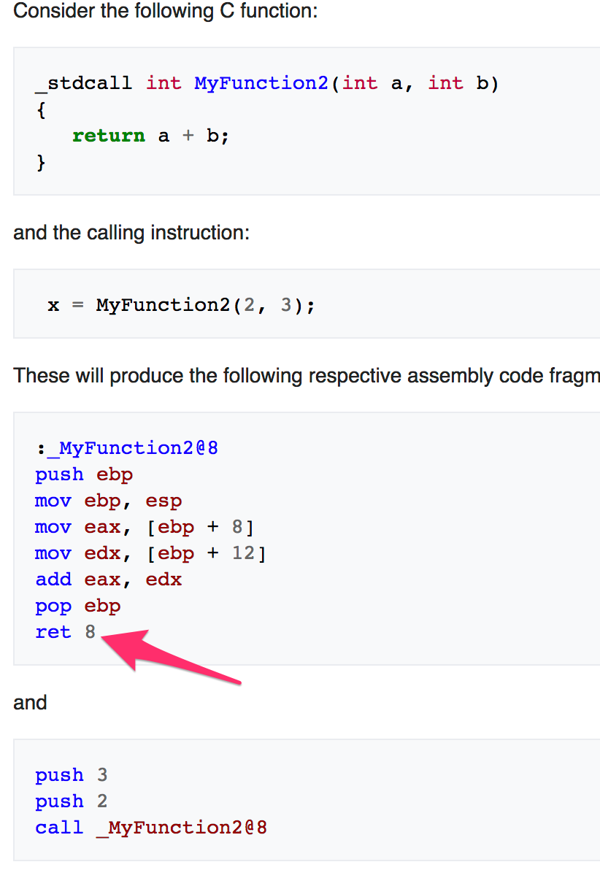
STDCALL
STDCALL, also known as "WINAPI" (and a few other names, depending on where you are reading it) is used almost exclusively by Microsoft as the standard calling convention for the Win32 API.
STDCALL passes arguments right-to-left, and returns the value in eax.
The called function cleans the stack, unlike CDECL. This means that STDCALL doesn't allow variable-length argument lists.
RET 8 ➔ RET + POP 8 Byte

Slide 11
FASTCALL
The FASTCALL calling convention is not completely standard across all compilers, so it should be used with caution.
The calling function most frequently is responsible for cleaning the stack, if needed.
Use ECX, EDX to pass the first two arguments

Slide 12
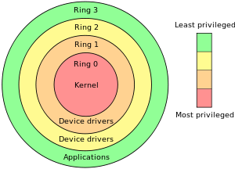
System Call

Slide 13
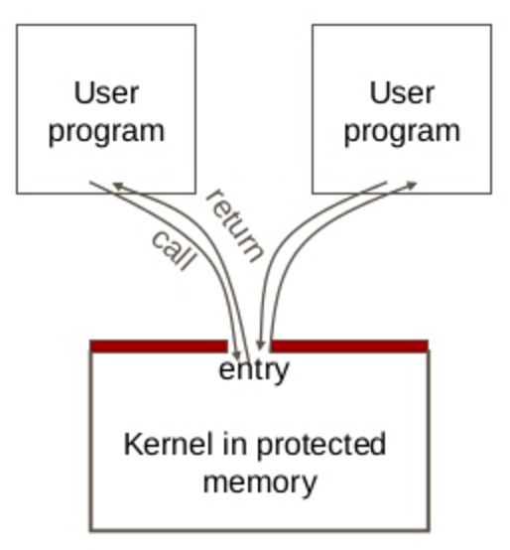
System Call
User code can be arbitrary
User code cannot modify kernel memory
The call mechanism switches code to kernel mode

Slide 14
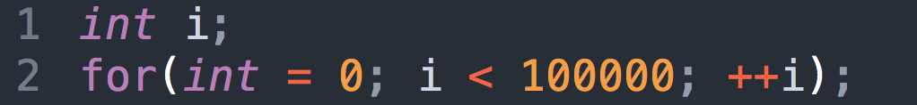
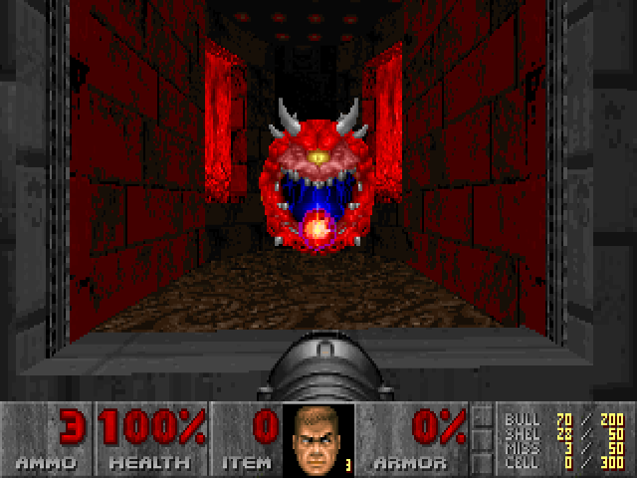
What is System Call?
System resources (file, network, IO, device) may be accessed by multiple applications at the same time, can cause confliction.
Modern OS protect these resources.
E.g. How to let a program to wait for a while?
100Mhz CPU -> 1s
1000Mhz CPU -> 0.1s
Use OS provide Timer

Slide 15
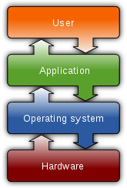
What System Call?
Let an application to access system resources.
OS provide an interface (System call) for the application
It usually use the technique called “interrupt vector”
Linux use 0x80
Windows use 0x2E
In system programming, an interrupt is a signal to the processor emitted by hardware or software indicating an event that needs immediate attention. An interrupt alerts the processor to a high-priority condition requiring the interruption of the current code the processor is executing. The processor responds by suspending its current activities, saving its state, and executing a function called an interrupt handler (or an interrupt service routine, ISR) to deal with the event. This interruption is temporary, and, after the interrupt handler finishes, the processor resumes normal activities.^{[1]} There are two types of interrupts: hardware interrupts and software interrupts. – From Wikipedia

Slide 16
CPU Interrupt
User Mode Execution
Interruption occurred
Next instruction
User Mode
Kernel Mode
Interrupt Vector Table
Interrupt Handler

Slide 17
Windows System Call and API
The Win32 API is a layer that runs in user mode (ring 3). Windows used to also support an OS/2 and POSIX API layer but they fell into disuse and were removed. The window manager is pure user mode code, no kernel calls are involved. Only API calls that use kernel resources (CreateThread, VirtualAlloc, etc) will call into the "real" operating system (ntdll.dll) and trap into ring 0 with a software interrupt (int 0x2e).

Slide 18
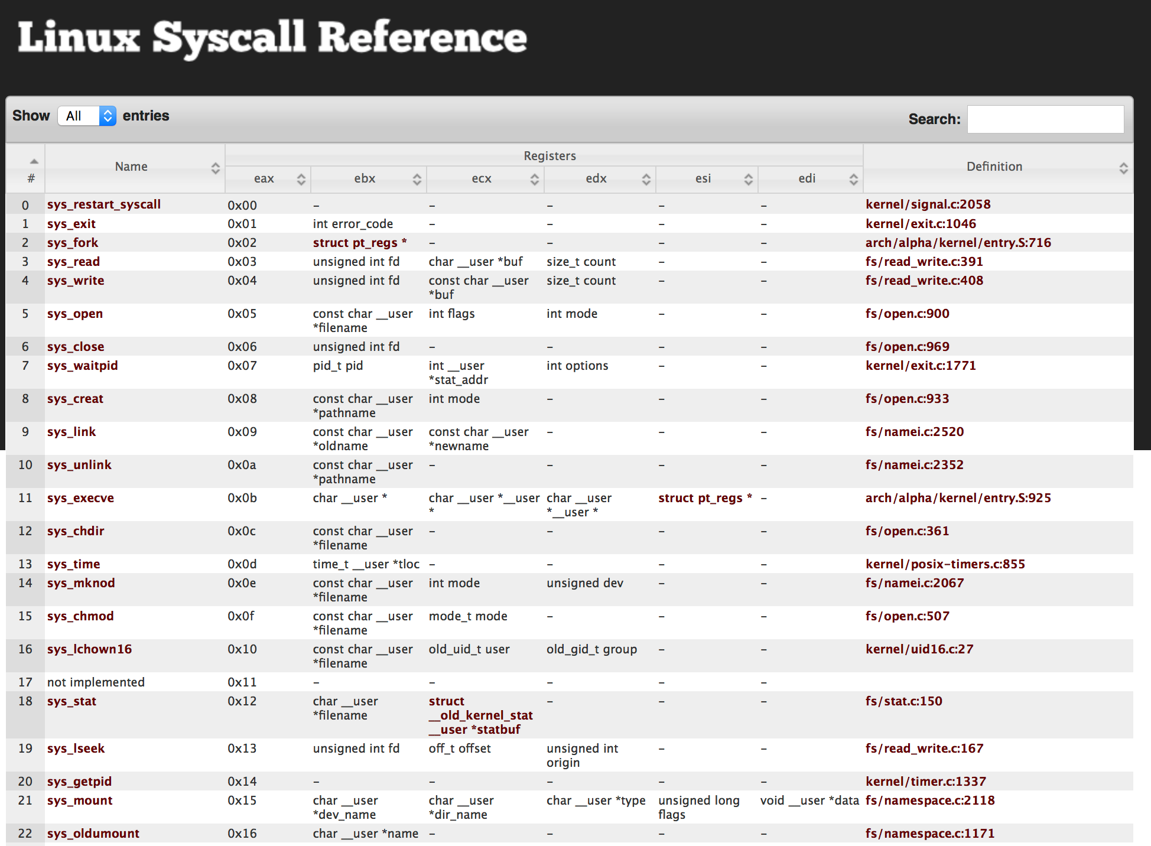
Linux System Call
http://syscalls.kernelgrok.com

Slide 19
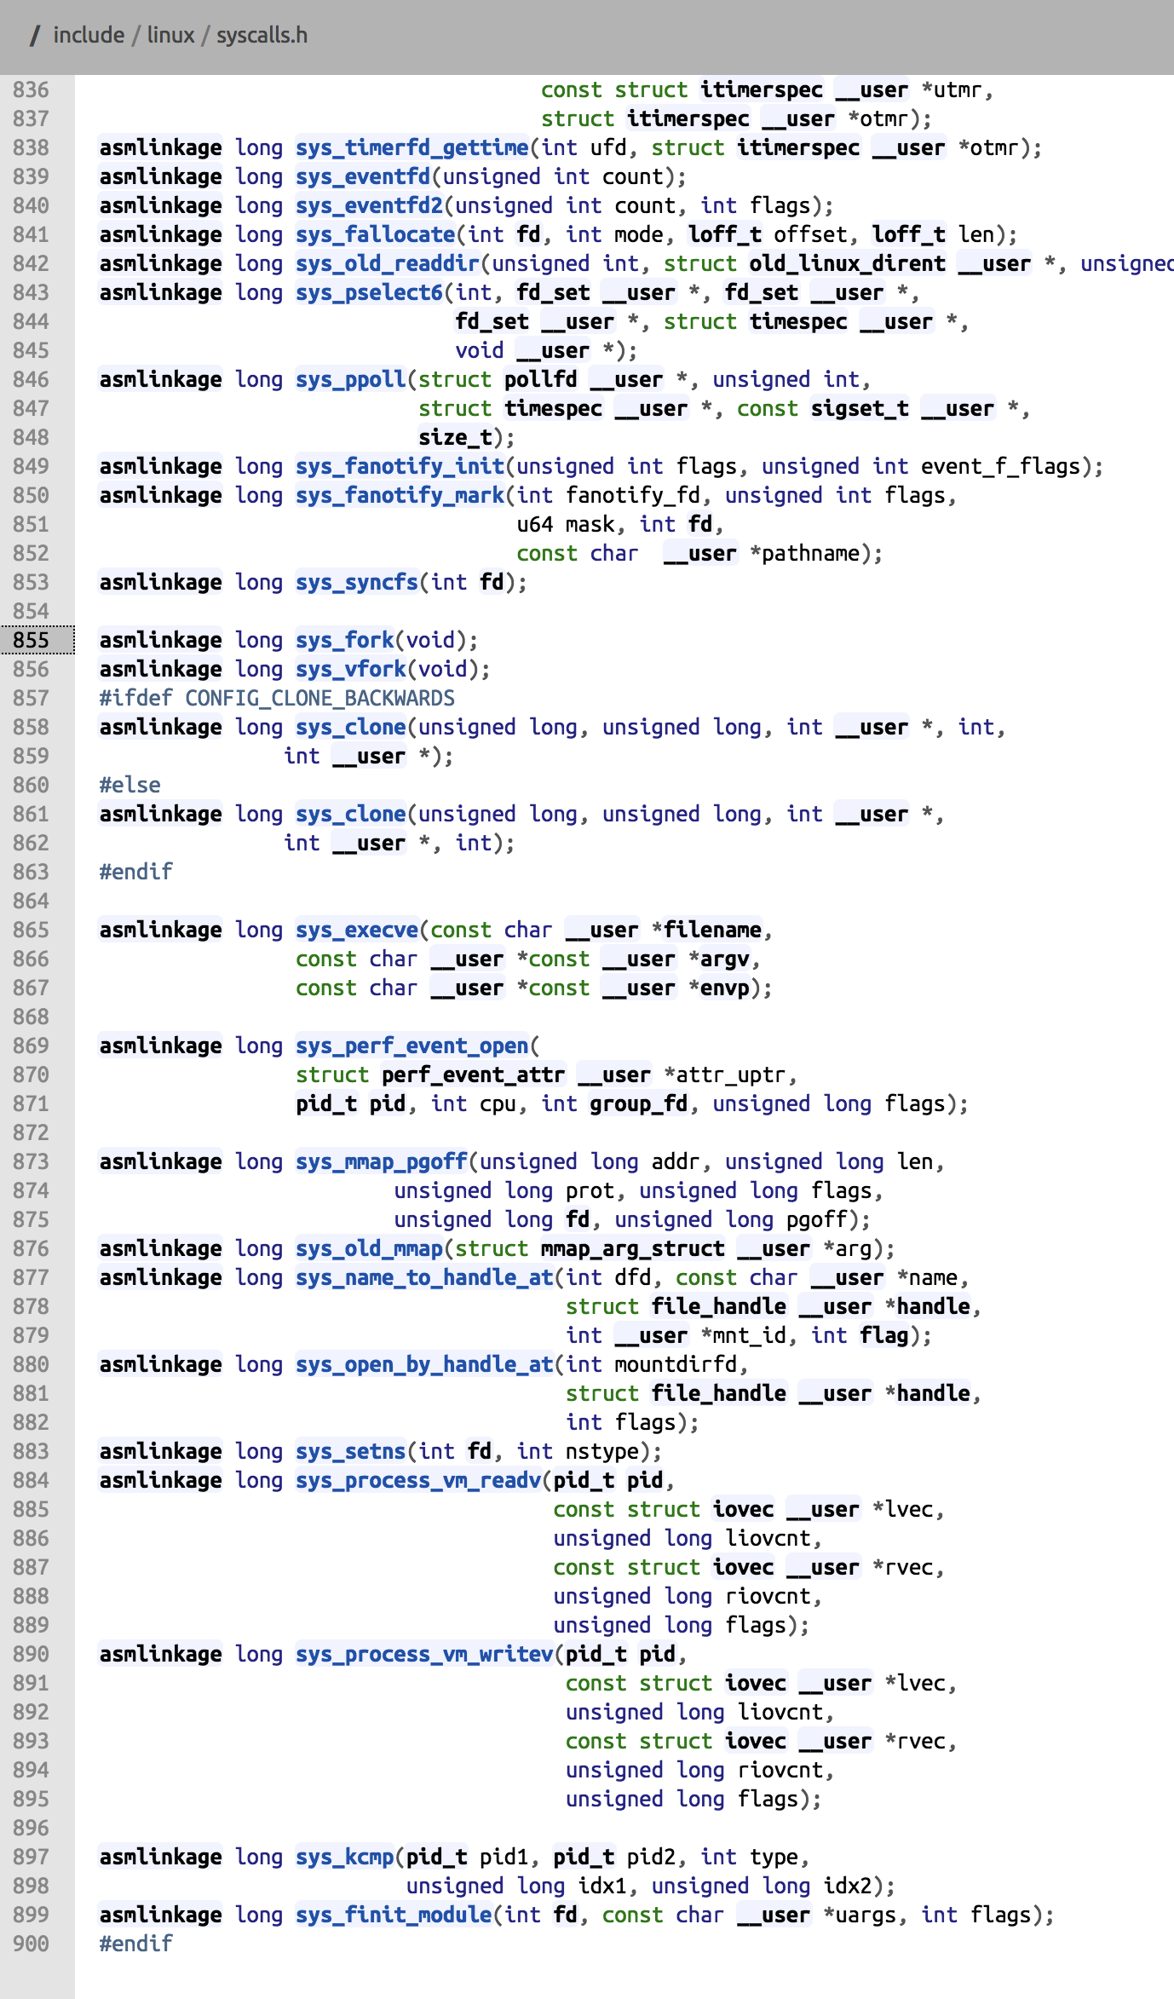

Slide 20
fwrite() path in both Linux and Windows
Application
fwrite()
./program
fwrite()
program.exe
C
Run Time
Library
write()
libc.a
libc.so
write()
Libcmt.lib
msvcr90.dll
libc.a
libc.so
interrupt 0x80
API (Windows)
NtWriteFile()
Kernel32.dll
NTDLL.dll
Interrupt 0x2e
Kernel
sys_write()
Kernel
./vlinuxz
IoWriteFile()
Kernel
NtosKrnl.exe

Slide 21
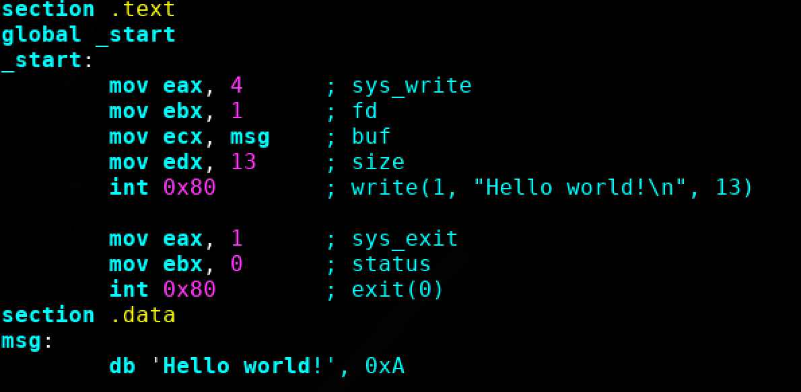
Example: Hello World
Quick review:
DB - Define Byte. 8 bits
DW - Define Word. Generally 2 bytes on a typical x86 32-bit system
DD - Define double word. Generally 4 bytes on a typical x86 32-bit system
From x86 assembly tutorial,
helloworld.asm

Slide 22
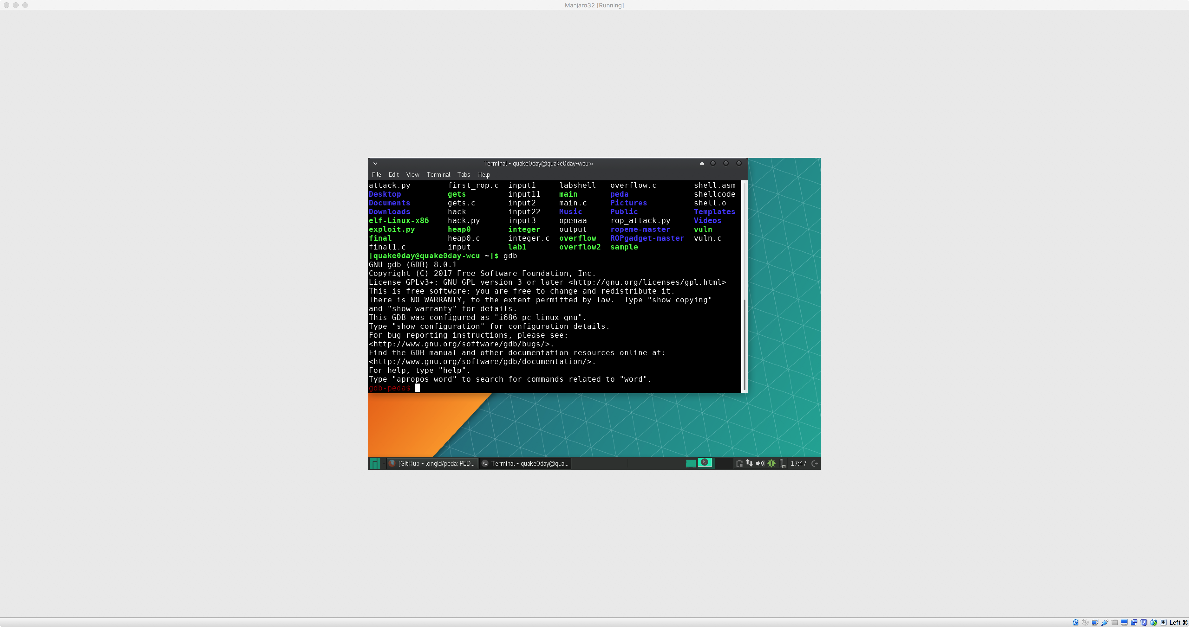
GDB with PEDA
GDB with PEDA and Pwntools are two tools that we will be using extensively throughout the course. This section is designed to run through their basic use and to work out any possible kinks that might arise.
GDB with PEDA

Slide 23
GNU Debugger - Basics
gdb
disassemble main (disas main)
set disassembly-flavor intel
break main (b main)
run
stepi (s), step into
nexti (n), step over

Slide 24
GNU Debugger – Examine Memory
Examine memory: x/NFU address
N = number
F = format
U = unit
• Examples
x/10xb 0xdeadbeef, examine 10 bytes in hex
x/xw 0xdeadbeef, examine 1 word in hex
x/s 0xdeadbeef, examine null terminated string

Slide 25
BASH refresher

Slide 26
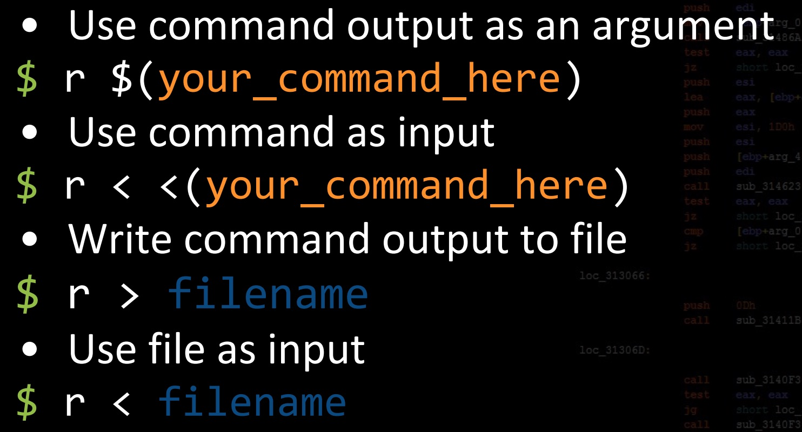
gdb io

Slide 27
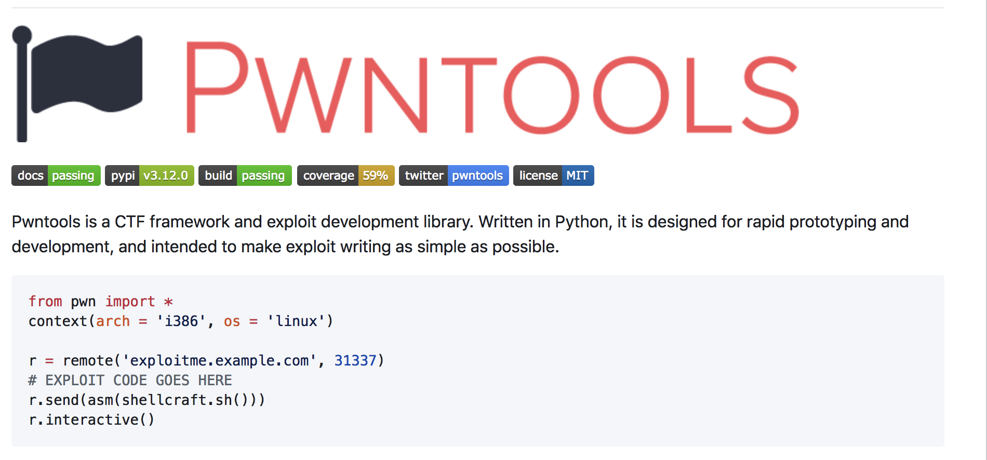
Pwntools
Pwntools is best supported on 64-bit Ubuntu LTE releases (12.04, 14.04, and 16.04). Most functionality should work on any Posix-like distribution (Debian, Arch, FreeBSD, OSX, etc.). Python 2.7 is required.

Slide 28
Q & A

